Slide 1

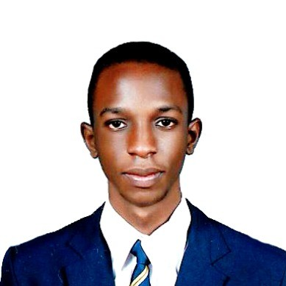
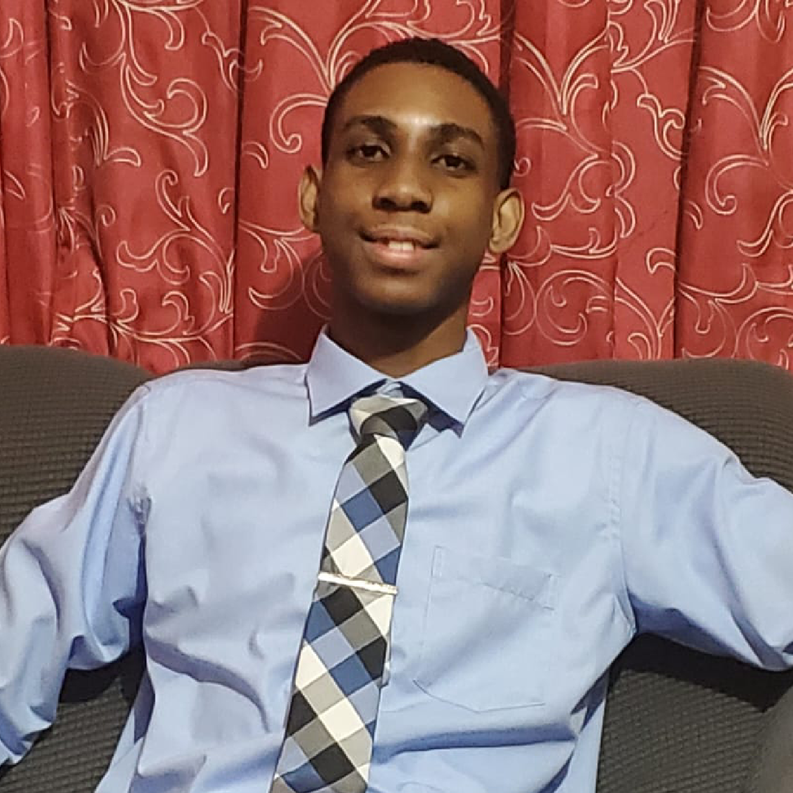

Innovate Challenge June 2025
AI-Powered Wildfire Command Center
Artemis Shield
Protecting Lives from Wildfires
The Team:
Adrian Tennant
Gary Bryan
Notes:
A pleasant day to you. My name is Adrian Tennant, and alongside my teammate, Gary Bryan, we are proud to present ArtemisShield: our AI-Powered Wildfire Command Center, built as our solution for the Microsoft Innovate Challenge.
Our mission is simple but critical: to leverage the full power of Microsoft Azure to protect lives from wildfires.

Slide 2
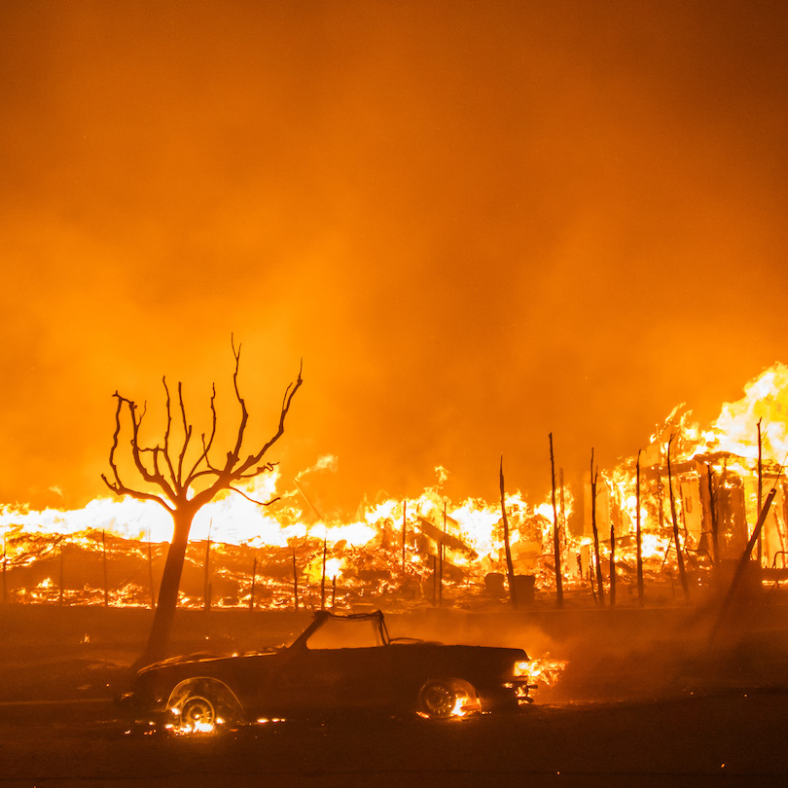
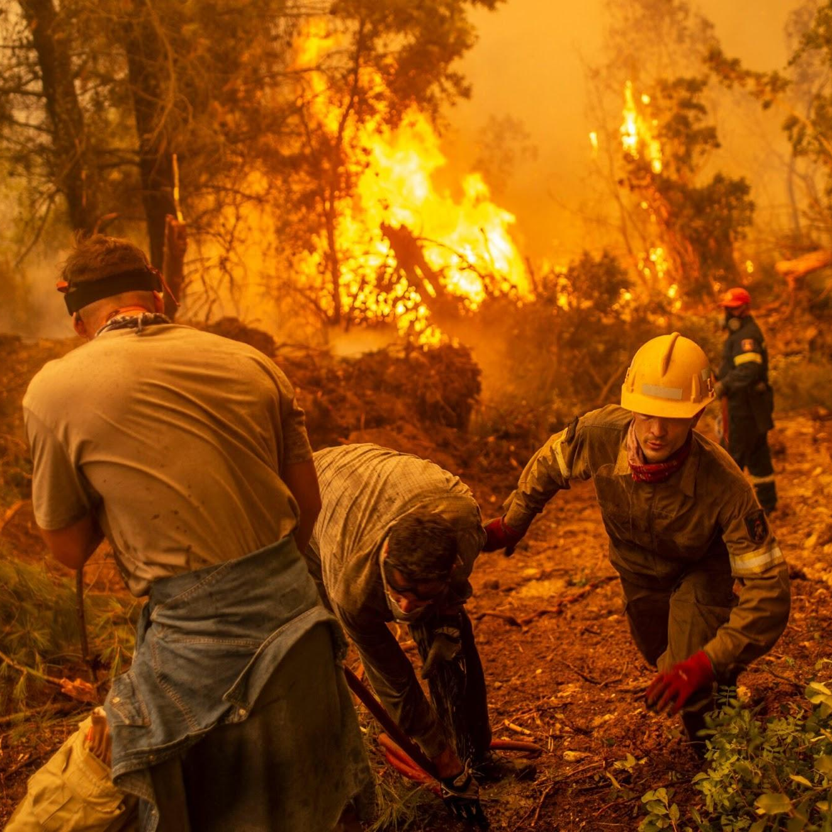
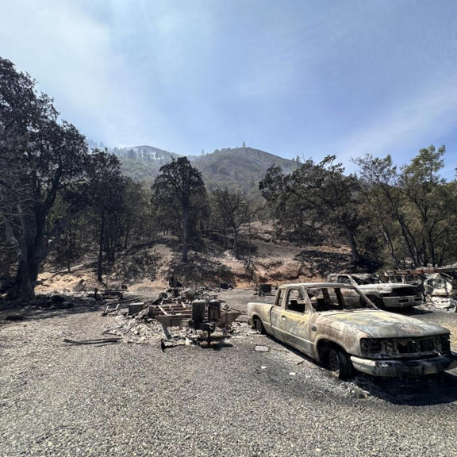
The Problem
Wildfires
Data Inadequacy
Consequences
A growing global threat worsened by Climate change
Fragmented data (satellites, field reports, weather), slow information synthesis, immense pressure on commanders.
Lives lost, property destroyed, environmental devastation.
Notes:
(Time: ~1 minute)
So the challenge were tackling is the growing global threat of wildfires, which is heavily influenced by our changing climate. But for the dedicated commanders tirelessly working against this danger, their efforts are severely hindered by what we call Data Inadequacy.
They're forced to try and piece together fragmented information from satellites, weather reports, and desperate calls from the field. This puts them under immense pressure, leading to critically slow information synthesis precisely when every second is vital.
The consequences are truly devastating: precious lives lost, properties obliterated, and irreparable environmental damage. This isn't merely a data problem; it's a profound human tragedy.
If you look at the image on the right. You can see an actual visual evidence of the recent Rowena fire, which tragically resulted in immense environmental devastation and some devastating loss of life.
—---------------------------------------------------------------------------------------------------------------------------------------------------------------------------------------------------------------------------------------
"The challenge we’re tackling is the worsening growth in the global threat of wildfires which is influenced heavily by semi-predictable climate change. But for our in field commanders who work selflessly against this threat, the progression of their work is being greatly challenge by Data Inadequacy.
They are forced to synthesize fragmented data from satellites, weather reports, and frantic calls from the field. This immense pressure leads to slow information synthesis when every second counts.
And the consequences are devastating: lives lost, property destroyed, and irreparable environmental damage. This is not just a data problem; it's a human problem."
Please bring your attention to the right most image which serves as visual evidence to the recent Rowena fire which lead to devastating amounts of environmental damage and loss of life.

Slide 3
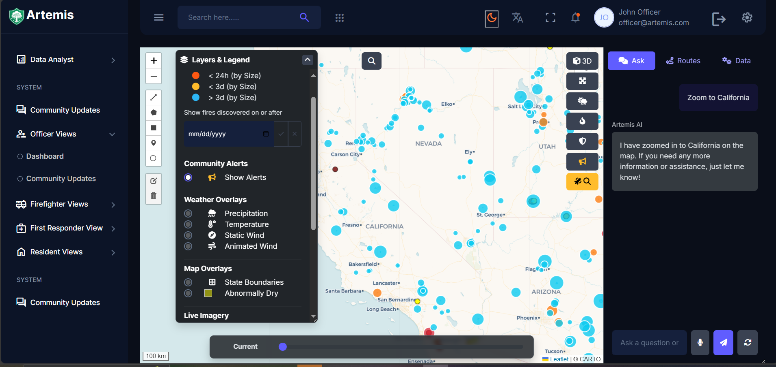
Our Solution: Artemis Shield
Your AI-Powered Command Center
Transforms reactive wildfire management into proactive, data-driven command and control
Centralize real-time information and significantly augment human decision-making with powerful Azure AI.
Notes:
And our solution to all this is ArtemisShield, an intelligent co-pilot for wildfire commanders. Artemis Shield completely shifts how they operate, moving from just reacting to fires to actively managing them with data. It pulls all the real-time info into one easy-to-use, interactive dashboard, and crucially, it boosts human decision-making with powerful Azure AI. This isn't just a static map; it's a "living operational picture" where commanders can see live fire details, community alerts, and even talk to the Artemis AI agent.
—---------------------------------------------------------------------------------------------------------------------------------------------------------------------------------------------------------------------------------------
Artemis Shield is an intelligent co-pilot for wildfire commanders, transforming reactive management into a proactive, data-driven system. It centralizes real-time information into one interactive dashboard, significantly augmenting human decision-making with powerful Azure AI Services. This "living operational picture" allows commanders to see live fire data and community alerts, and even interact with an Artemis AI agent.
—---------------------------------------------------------------------------------------------------------------------------------------------------------------------------------------------------------------------------------------
"This is where ArtemisShield comes in. We asked: what if commanders had an intelligent co-pilot to navigate this chaos? Our solution transforms reactive wildfire management into a proactive, data-driven command and control system. ArtemisShield centralizes all real-time information into one interactive dashboard, but more importantly, it significantly augments human decision-making with powerful Azure AI Services. [Action: Point to the screenshot on the slide]. What you're seeing here isn't just a map with dots. It's a living operational picture, where a commander can see live fire data, community alerts, and even have a conversation with the map itself, as you can see with our Artemis AI agent on the right."

Slide 4
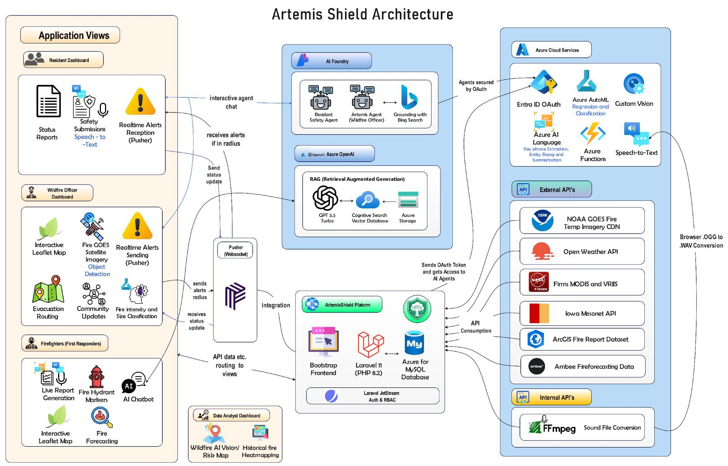
Notes:
To make this possible, we architected a robust, cloud-native solution that is both powerful and scalable. Let me give you a quick tour of how it all works.
[Action: Use your mouse to trace the flow from left to right]
On the left, our role-based dashboards allow officers to command, firefighters to report, and residents to stay safe. These views all connect to our central ArtemisShield Platform—a Laravel backend hosted on Azure App Services that orchestrates every request and service.
The brain of our operation is the Azure Cloud Services layer in the top right.
We use AI Foundry with Agents , secured by Entra ID, to deploy an interactive agent for the wildfire officer, grounded with real-time Bing Search.
For firefighters, we built a separate RAG-based agent, combining Azure OpenAI with Cognitive Search to provide instant, accurate answers from their field manuals and strategic decision making based on previous wildfire encounter reports.
Our predictive core uses AutoML for intensity forecasting and Custom Vision to automatically detect new fires in NOAA satellite imagery.
And this entire system is fueled by a live Data Ingestion Layer, pulling mission-critical data from sources like NASA FIRMS and ArcGIS."

Slide 5
Key Sources
Fire Temperature Imagery CDN - https://www.star.nesdis.noaa.gov/GOES/index.php
Weather Data - Current weather and forecast - OpenWeatherMap
Fire Stations, Fire Hydrants Location - openstreetmap.org
Satellite MODIS, VIIRS HotSpots and Fire History Dataset - NASA | LANCE | FIRMS
Wildfire Prediction Dataset - https://www.kaggle.com/datasets/abdelghaniaaba/wildfire-prediction-dataset/
Auto ML Classification and Regression Dataset respectively- 1.88 Million US Wildfires , NASA | LANCE | FIRMS
Ambee Fire Forecasting Data - Ambee | Climate & environmental intelligence for the world
Iowa Mesonet US Weather Layer - MapServer Message
Notes:
So our platform runs on some really great, diverse data. We pull information from places like NASA FIRMS, NOAA, OpenWeatherMap, and OpenStreetMap, plus we've got a huge historical wildfire dataset. This whole mix lets us do a few key things: we can detect fires live, predict how big and intense they'll get, understand the environment around them, and pinpoint exactly what infrastructure might be at risk.
—---------------------------------------------------------------------------------------------------------------------------------------------------------------------------------------------------------------------------------------
Our platform leverages diverse high-quality data from NASA FIRMS, NOAA, OpenWeatherMap, Iowa Mesonet, Ambee, and OpenStreetMap, combined with a massive historical wildfire dataset, to power live fire detection, predictive models for fire size and intensity, and environmental understanding, identifying at-risk infrastructure.
—---------------------------------------------------------------------------------------------------------------------------------------------------------------------------------------------------------------------------------------
Our platform is built on a foundation of diverse, high-quality data.
For live fire detection, we pull satellite hotspots from NASA FIRMS and feed live imagery from NOAA directly into our Azure Custom Vision model.
Our predictive mode.ls were trained on a massive historical dataset of over 1.88 million US wildfires, allowing our AutoML model alongside and heuristic to predict relatively good forecasting fire fire size and intensity.
To understand the environment, we integrate live weather from OpenWeatherMap, visual overlays from the Iowa Mesonet, and specialized forecasts from Ambee.
Finally, OpenStreetMap provides the critical ground-truth data on infrastructure, telling us exactly what's at risk and what’s in place to assist.

Slide 6






Key Features
Predictive Intelligence (Azure ML)
Voice-to-Text Reporting
(Azure Speech)
Interactive Geo-Dashboard(PWA)
Predicts fire intensity and spread
Transcribes live audio field reporting
Foundation of the system
AI Co-Pilot (Azure AI Agent)
Automated GOES Analysis (Custom Vision)
Real-Time Alerting (Pusher & Laravel Echo)
Showcases conversational AI and map interaction
Performs in depth examination using satellite imagery
Ensures immediate dissemination of critical updates
Notes:
Our platform is built around six key features that work together to create a complete command system.
It all starts with our Interactive Geo-Dashboard, a user-friendly and mobile-responsive PWA that serves as the foundation for everything.
Next is our AI Co-Pilot, powered by an Azure AI Agent. It's a true game-changer, allowing commanders to interact with the map using natural conversation.
We add Predictive Intelligence with Azure ML to forecast fire intensity, telling you not just where a fire is, but where it's going.
Our Automated GOES Analysis uses Custom Vision to find emerging fires in satellite imagery, often before they're officially reported.
In the field, Voice-to-Text Reporting via Azure Speech enables instant, hands-free reports from the ground.
And finally, Real-Time Alerting with Pusher ensures that critical updates and evacuation orders are sent to everyone instantly."

Slide 7
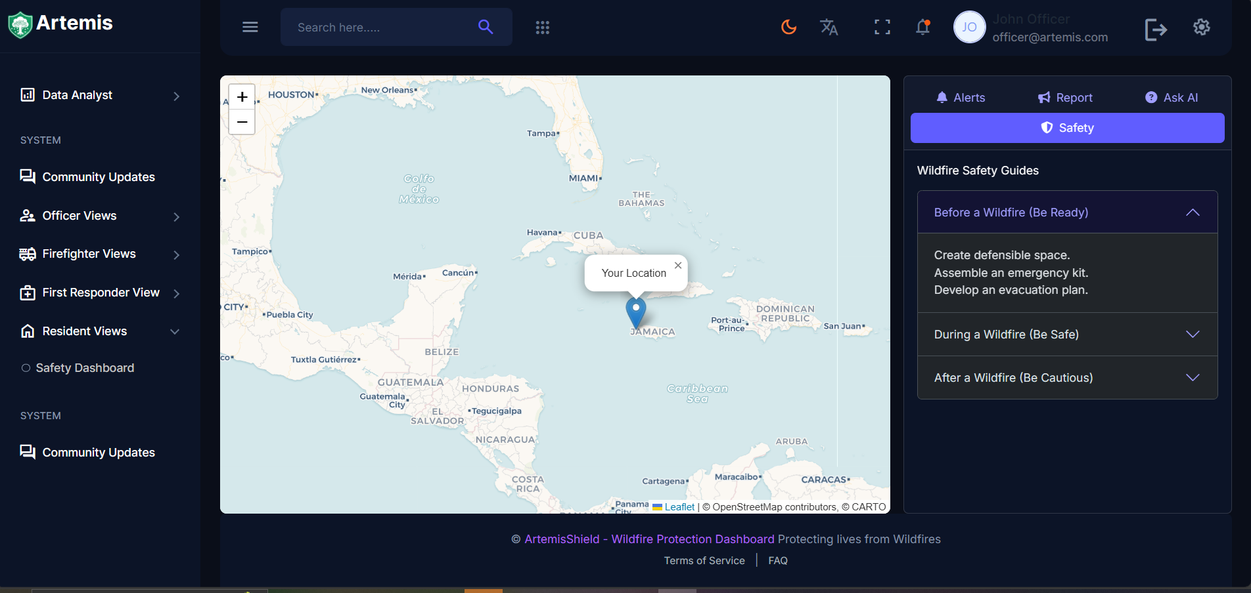
Demo - Artemis Dashboard
Notes:
This is the beginning of oru demo section, we would like to say: Theory is one thing, but performance is another. Let's move to the live demo and see what Artemis Shield can really do.

Slide 8

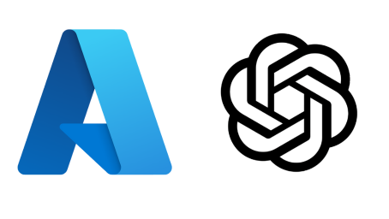

Azure Custom Vision
Technology Under the Hood
Trains our models for early wildfire hotspot detection in satellite imagery, offering critical lead time.
Azure OpenAI
Azure AI Agent
Powers the Co-Pilot's advanced natural language understanding and generation, enabling intelligent conversation and insights.
Orchestrates our AI Co-Pilot, understanding complex natural language queries and connecting to various tools to fulfill requests.
Notes:
Let's briefly look at the key Azure technologies you just saw.
We use Azure Custom Vision, trained on NOAA fire temperature images, to automatically detect hotspots and give officers critical lead time.
The core of our interactivity is the Azure AI Agent, managed in AI Foundry. This service orchestrates the officer's co-pilot, using Azure OpenAI to understand complex voice and text commands—from zooming across the map to assessing infrastructure risk."

Slide 9
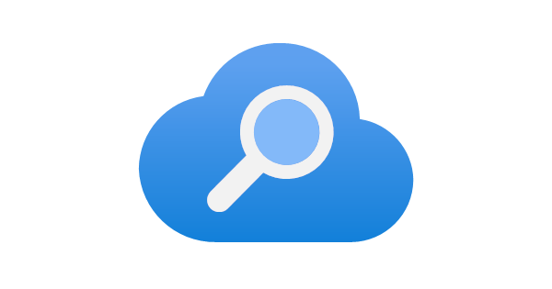
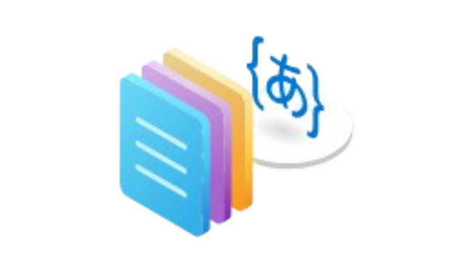

Azure AI Language
Azure AI Search
Extracts key entities like locations and resources from text reports, structuring unstructured data for immediate use.
Provides intelligent, semantic search capabilities for our Firefighter AI Chatbot, ensuring fast and accurate data retrieval for complex queries.
Azure AI Speech
Technology Under the Hood
Transcribes voice field reports into text instantly, enabling hands-free, rapid data entry from the ground.
Notes:
On the data processing side, we use Azure AI Language to extract key entities like locations and resources from unstructured field reports, making that data immediately useful.
Our Firefighter AI Chatbot is powered by Azure AI Search, which provides fast, accurate, semantic retrieval from our knowledge base of operational documents.
And finally, Azure AI Speech is the bridge between the field and our system, instantly transcribing voice reports into text and enabling hands-free, rapid data entry from the ground."

Slide 10





Our Reach for Responsible AI
Inclusiveness
Fairness
The system is designed to be openly accessible to a wide range of users an communities.
Transparency
AI model trained on diverse data to prevent bias; natural language translation.
Architecture documented; AI Agent explains its actions; open-source nature.
Reliability & Safety
Accountability
AI outputs clearly labeled, with confidence scores; verified data sources.
Designed as a decision-support tool, keeping humans in the loop.
Notes:
We built ArtemisShield to be powerful and ethical, strictly following Microsoft's Responsible AI. This means fairness (diverse data prevents bias), reliability (clear confidence scores), and inclusiveness (accessible for everyone). We're big on transparency – you see how it works and the AI explains itself. Ultimately, ArtemisShield is a decision-support tool; it helps commanders, but never replaces their vital human judgment.
—--------------------------------------------------------------------------------------------------------------------------------------------------------------------------------------------------------------------------------------
We think it's crucial that ArtemisShield isn't just powerful, it's ethical. We really follow Microsoft's Responsible AI guidelines. That means we're all about fairness – our models learn from diverse global data to avoid bias. We also make sure it's reliable and safe, showing you how confident the AI is. For inclusiveness, we've designed it to be helpful and accessible for everyone, no matter their background. And we're big on transparency; you can see how it works and the AI explains itself. But the most important thing? ArtemisShield is a decision-support tool. It helps commanders, but never replaces their judgment. We always keep the human in charge.
—--------------------------------------------------------------------------------------------------------------------------------------------------------------------------------------------------------------------------------------
Time: ~1 minute) [Action: Switch back to the presentation] "Finally, building a tool this powerful requires a deep commitment to ethics. We designed ArtemisShield with Microsoft's Responsible AI standards as our guide. For Fairness, our models are trained on diverse global data to prevent geographic bias. For Reliability and Safety, all AI outputs are clearly labeled with confidence scores to prevent over-reliance. For Inclusiveness, we ensure our system is designed to be accessible and beneficial for a wide range of users and communities, considering varied needs and contexts. For Transparency, our architecture is fully documented, and the AI Agent explains its actions. And most importantly, for Accountability, ArtemisShield is designed as a decision-support tool. It keeps the human commander in the loop for all critical decisions, augmenting their expertise, not replacing it

Slide 11
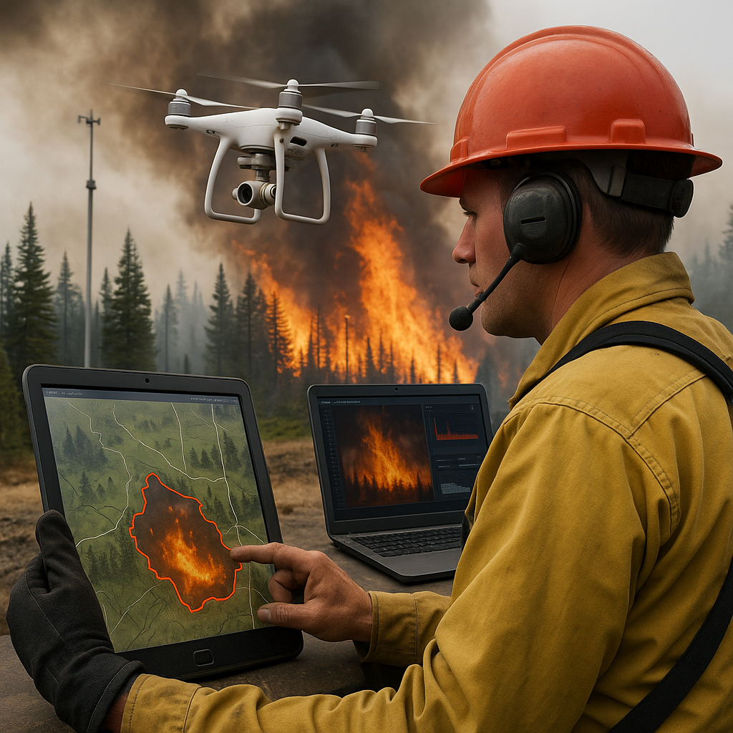

Enhanced AI Orchestration
The Future of Wildfire Management
Smarter Decision-Making
Increased Automation & Efficiency
Adaptive Intelligence
Dedicated Mobile App Fontend
Enhanced Field Operability
Push Notifications
Deeper Device Integration
Integrate With External App Services
SMS/MMS Gateways
Social Media APIs
Notes:
"This is just the beginning. The future of ArtemisShield involves enhancing our AI orchestration for even smarter decision-making, developing a dedicated mobile frontend for deeper field integration, and connecting with external services like SMS gateways and social media APIs or platforms to ensure public alerts reach everyone, everywhere."

Slide 12
Thank you
June 2025
Notes:
Thank you for your time and attention. We believe Artemis Shield represents a new frontier in wildfire management, powered by the incredible capabilities of Microsoft Azure.. For Any questions or dialogue please feel free to reach out to us through our github or linkedin

